Slide 1




Slide 2

Disclaimer
Please remember that past performance may not be indicative of future results. Different types of
investments involve varying degrees of risk, and there can be no assurance that the future performance
of any specific investment, investment strategy, or product made reference to directly or indirectly in this
presentation, will be profitable, equal any corresponding
indicated historical performance level(s),
or be suitable for your portfolio. Due to various factors, including changing market conditions, the content
may no longer be reflective of current opinions or positions. Moreover, you should not assume that any
discussion or information contained in this presentation (article) serves as the receipt of, or as a substitute
for, personalized investment advice from Brian, Johnathan, Josh, or Oscar. To the extent that a reader has any
questions regarding the applicability of any specific issue discussed above to his/her individual situation,
he/she is encouraged to consult with the professional advisor of his/her choosing. A copy of our current
written disclosure statement discussing our advisory services and fees is available for review upon
request.

Slide 3

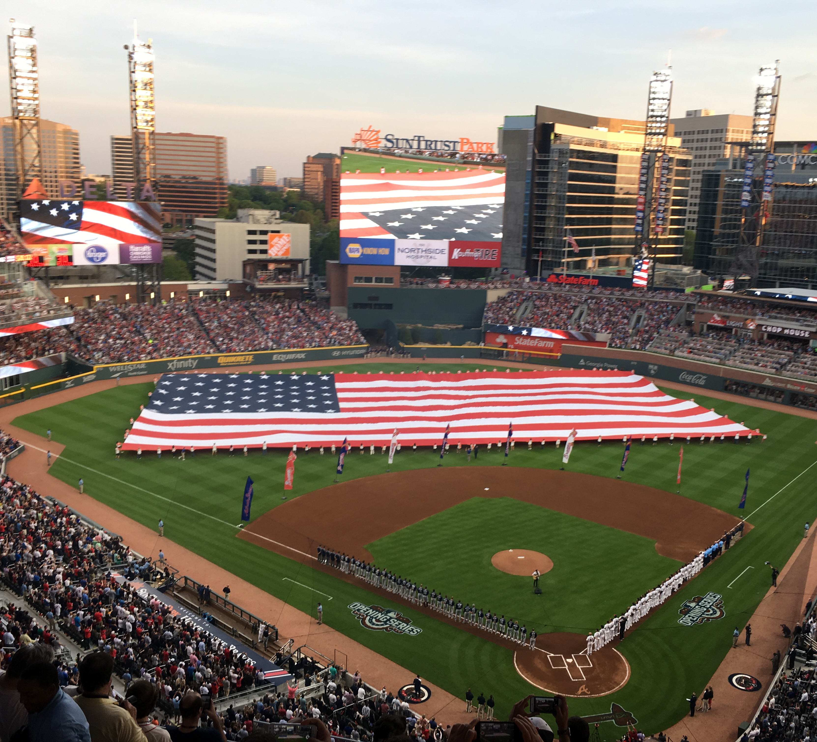
Project Overview
Step 1:
Collect Baseball stats and build predictive model
Step 2:
Run four different betting methods
Step 3:
Print money

Slide 4

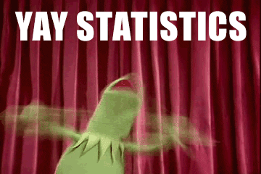
Baseball Stats
Baseball stats were pulled from Pybaseball, a free API that pulls the daily stats for each player who played on that particular day
Due to the inherent statistical nature of baseball, we collected hundreds of stats, but not all of them had any statistical relevance in predicting winners and losers

Slide 5
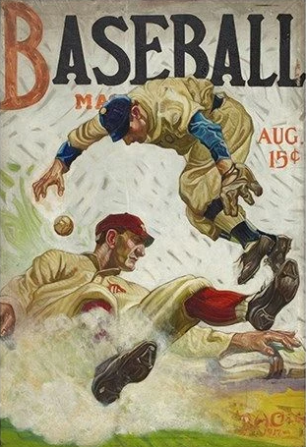
Building the Model
SVM
Deep Neural Network
Random Forest
AdaboostClassifier

Slide 6
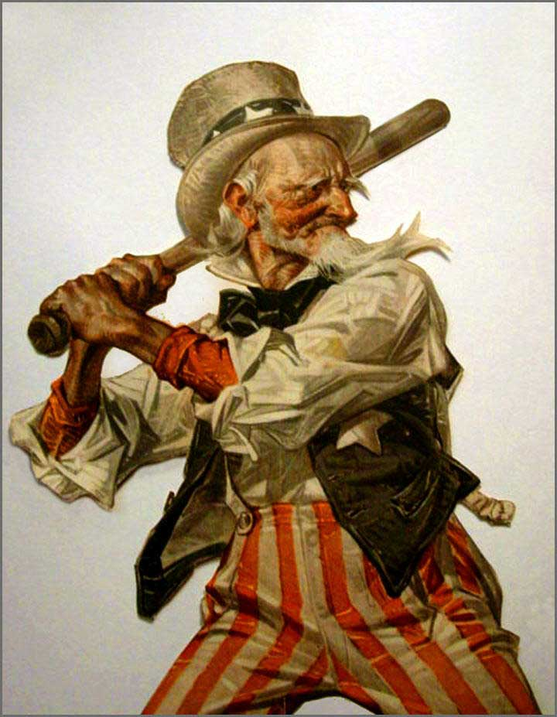
Betting
Money Line
Favorites
Underdogs
Negative/Positive Odds

Slide 7

Betting Methods
Betting on underdogs is the more lucrative choice, since you only need to be right about 45% of the time to break even, compared to 61% to break even when betting on favorites to win

Slide 8
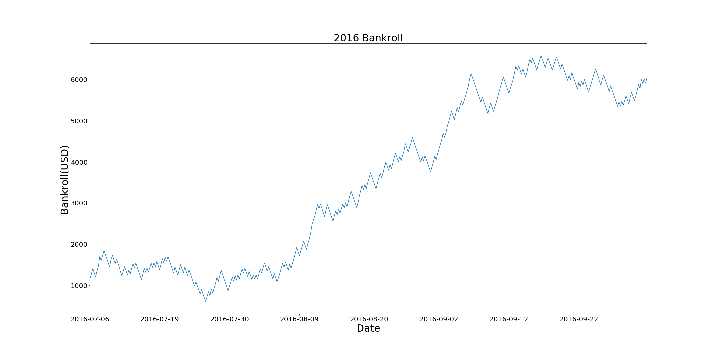
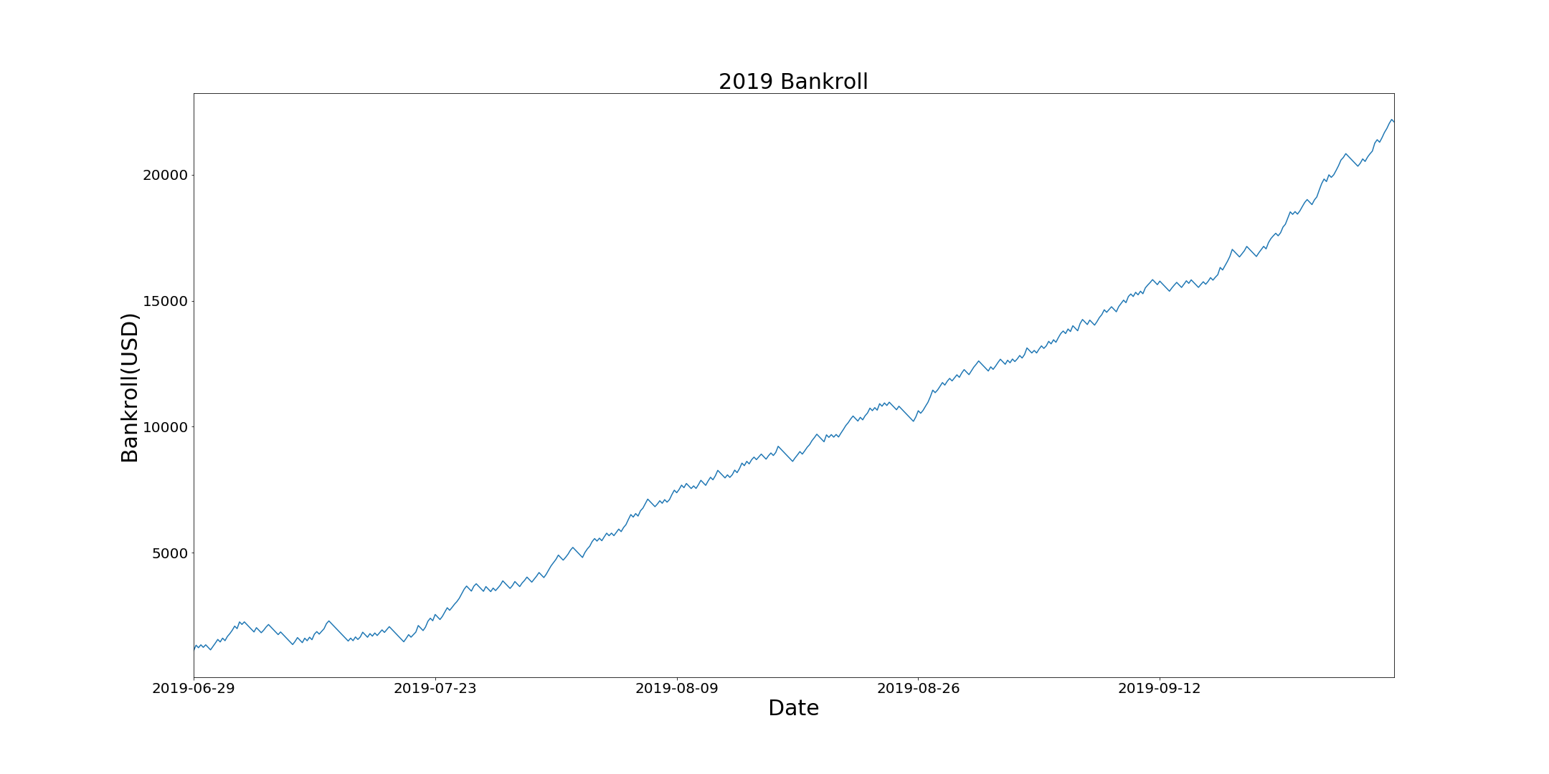
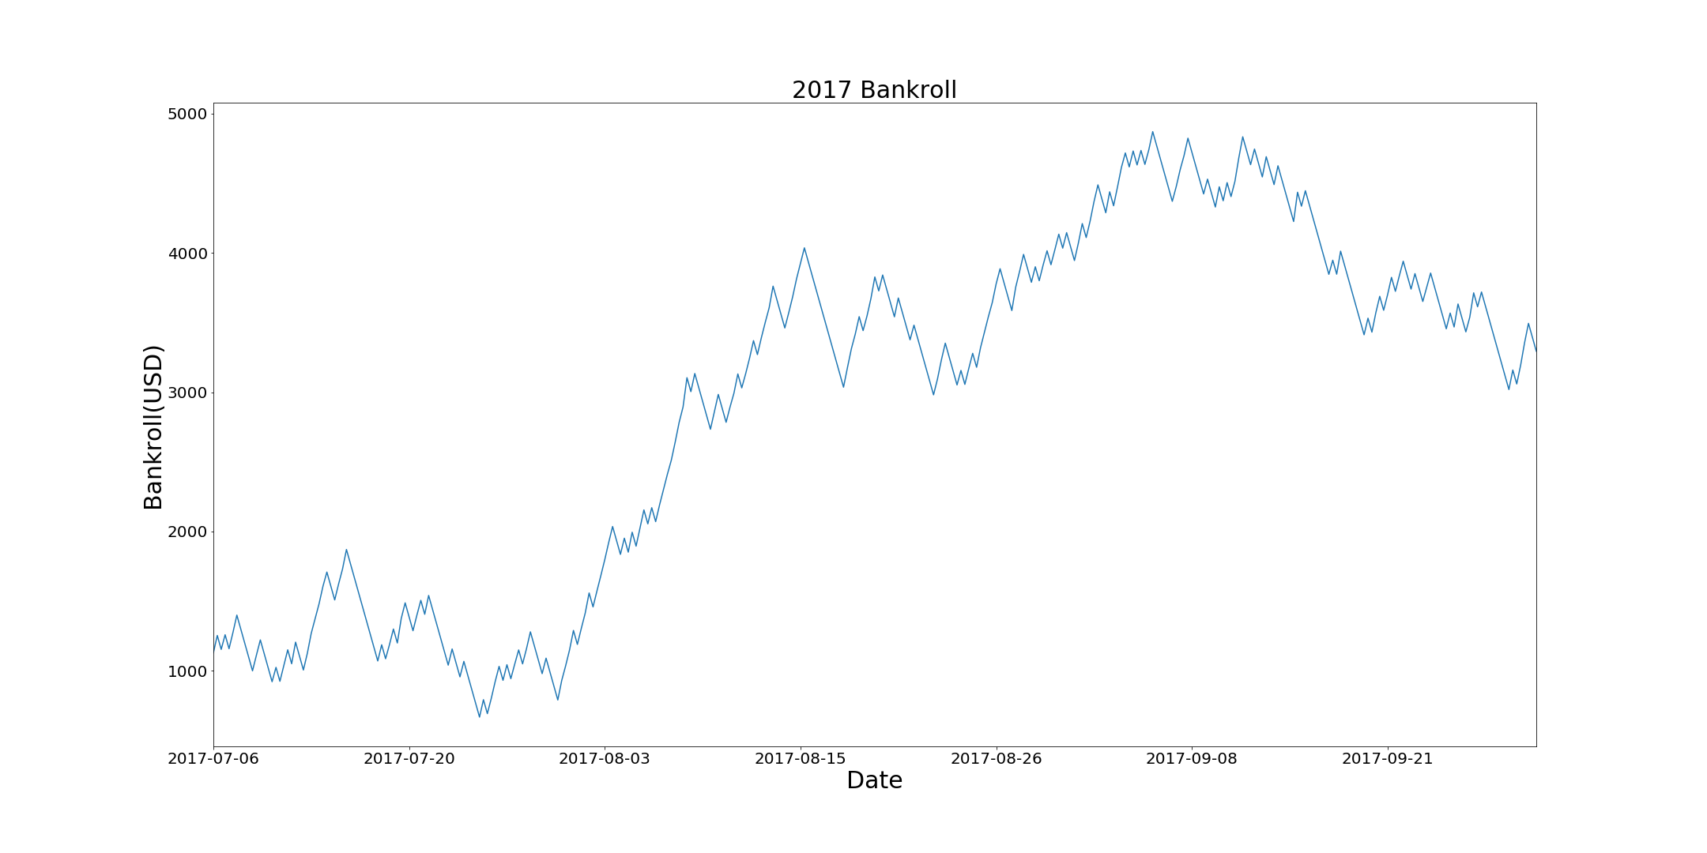
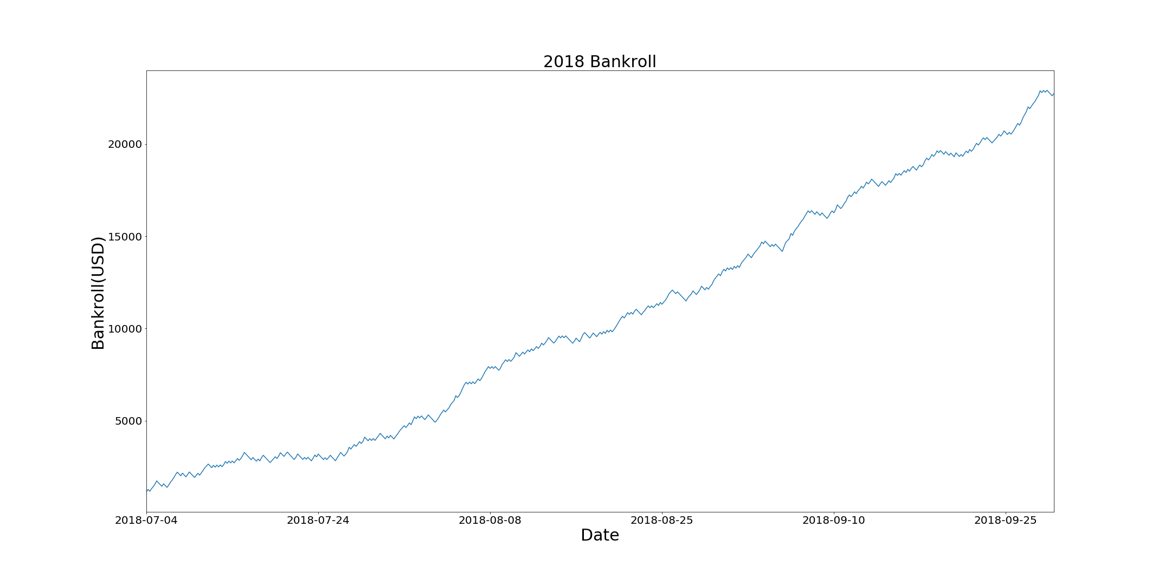
Results
2016
Final Sum: $6,051
2017
Final Sum: $3,294
2018
Final Sum: $22,734
2019
Final Sum: $22,099

Slide 9
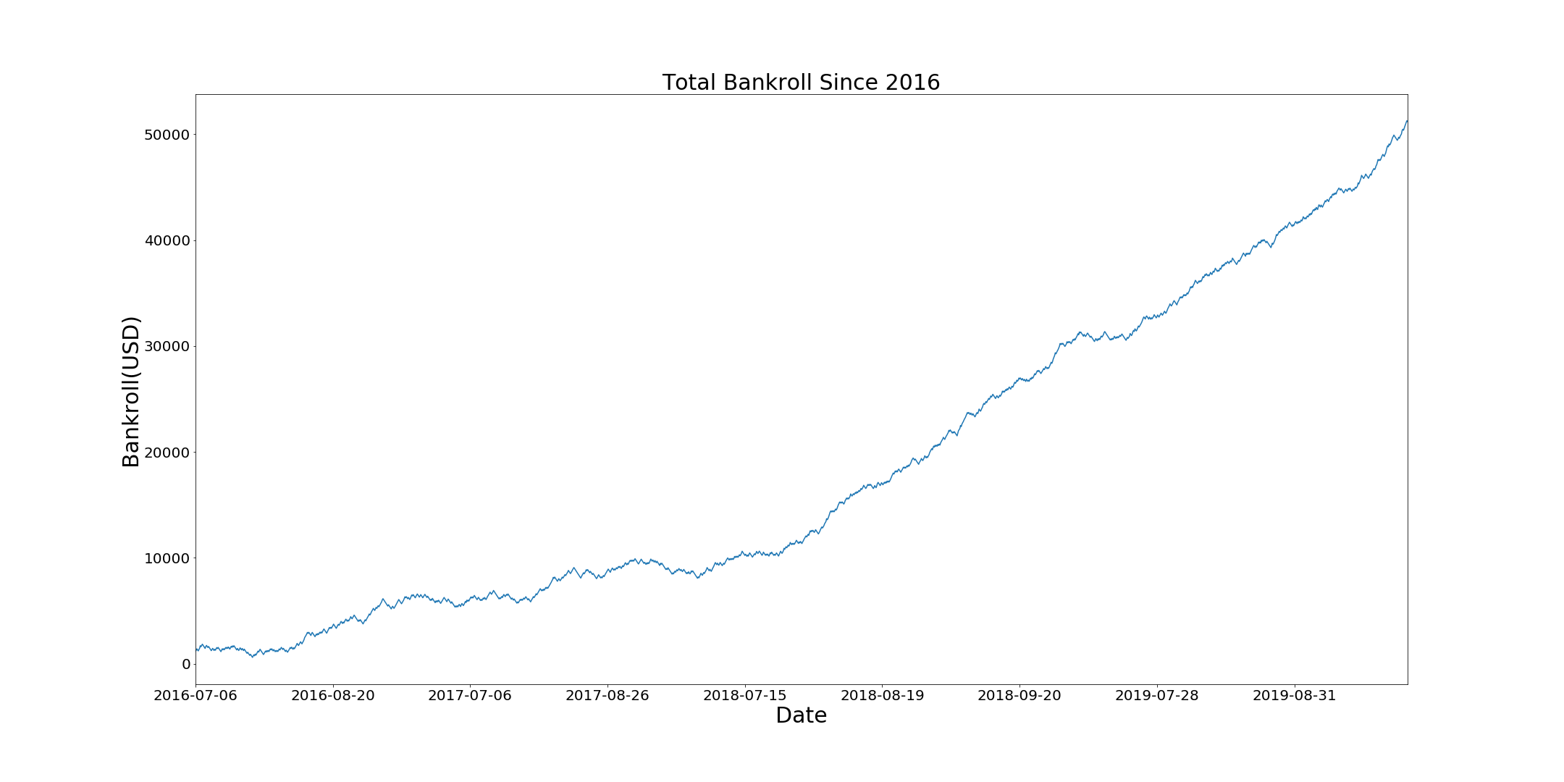
Bankroll
With an initial bankroll of $1000 starting on July 6, 2016, we would have finished with a sum of $51,178
Over a 5000% increase

Slide 10
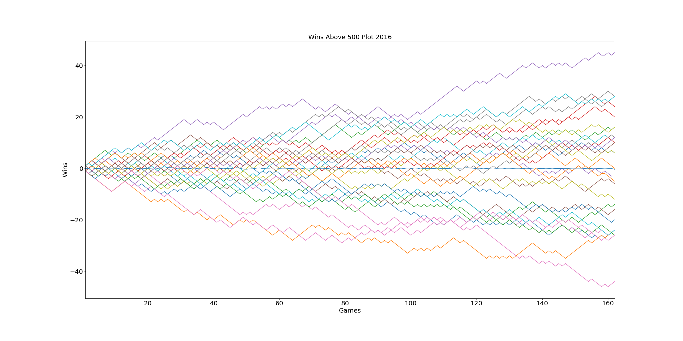
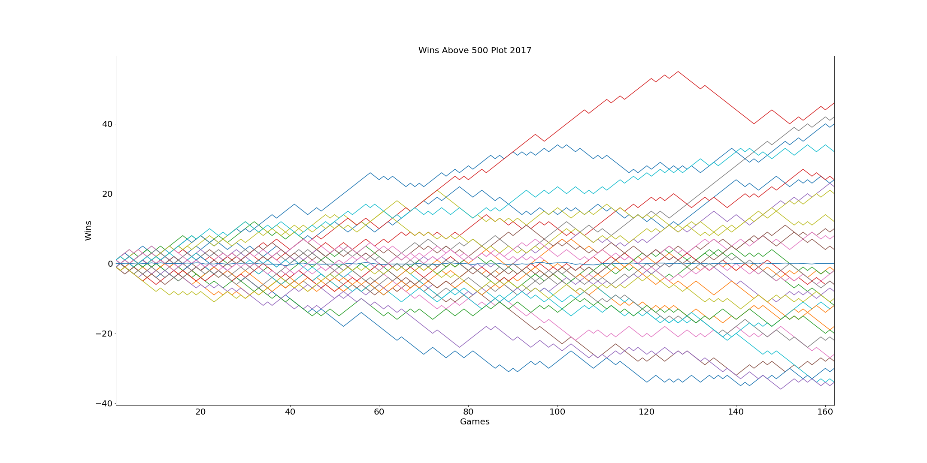

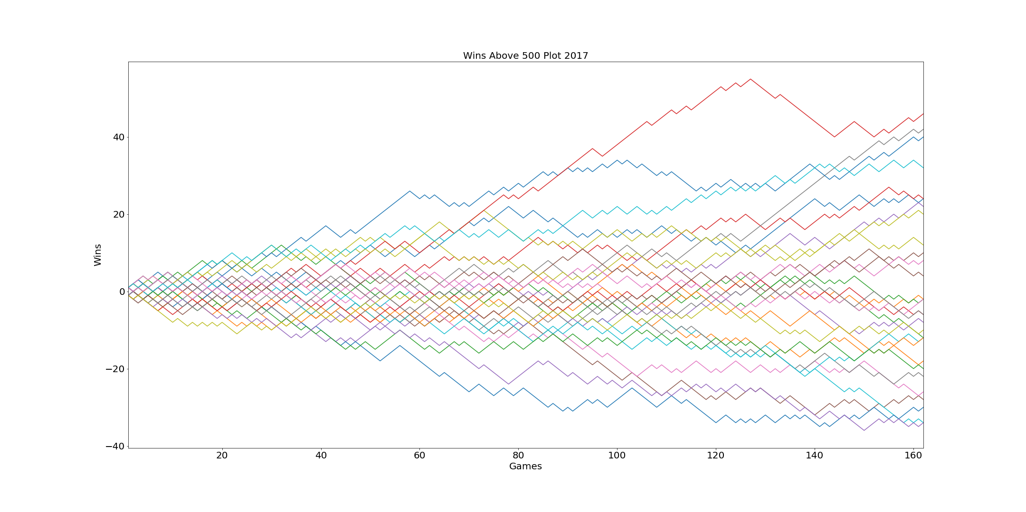
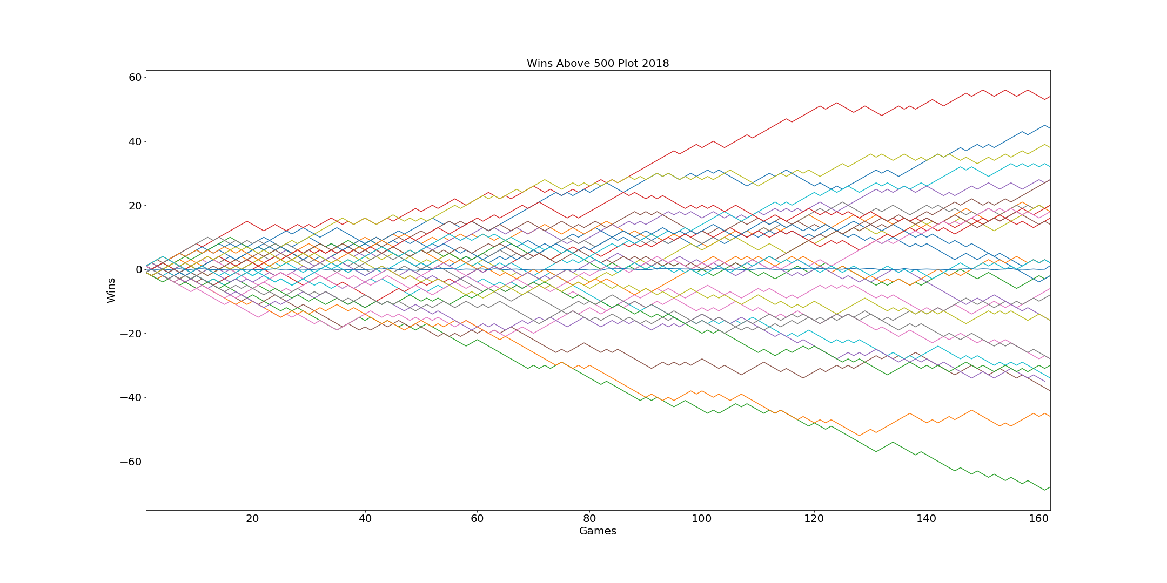
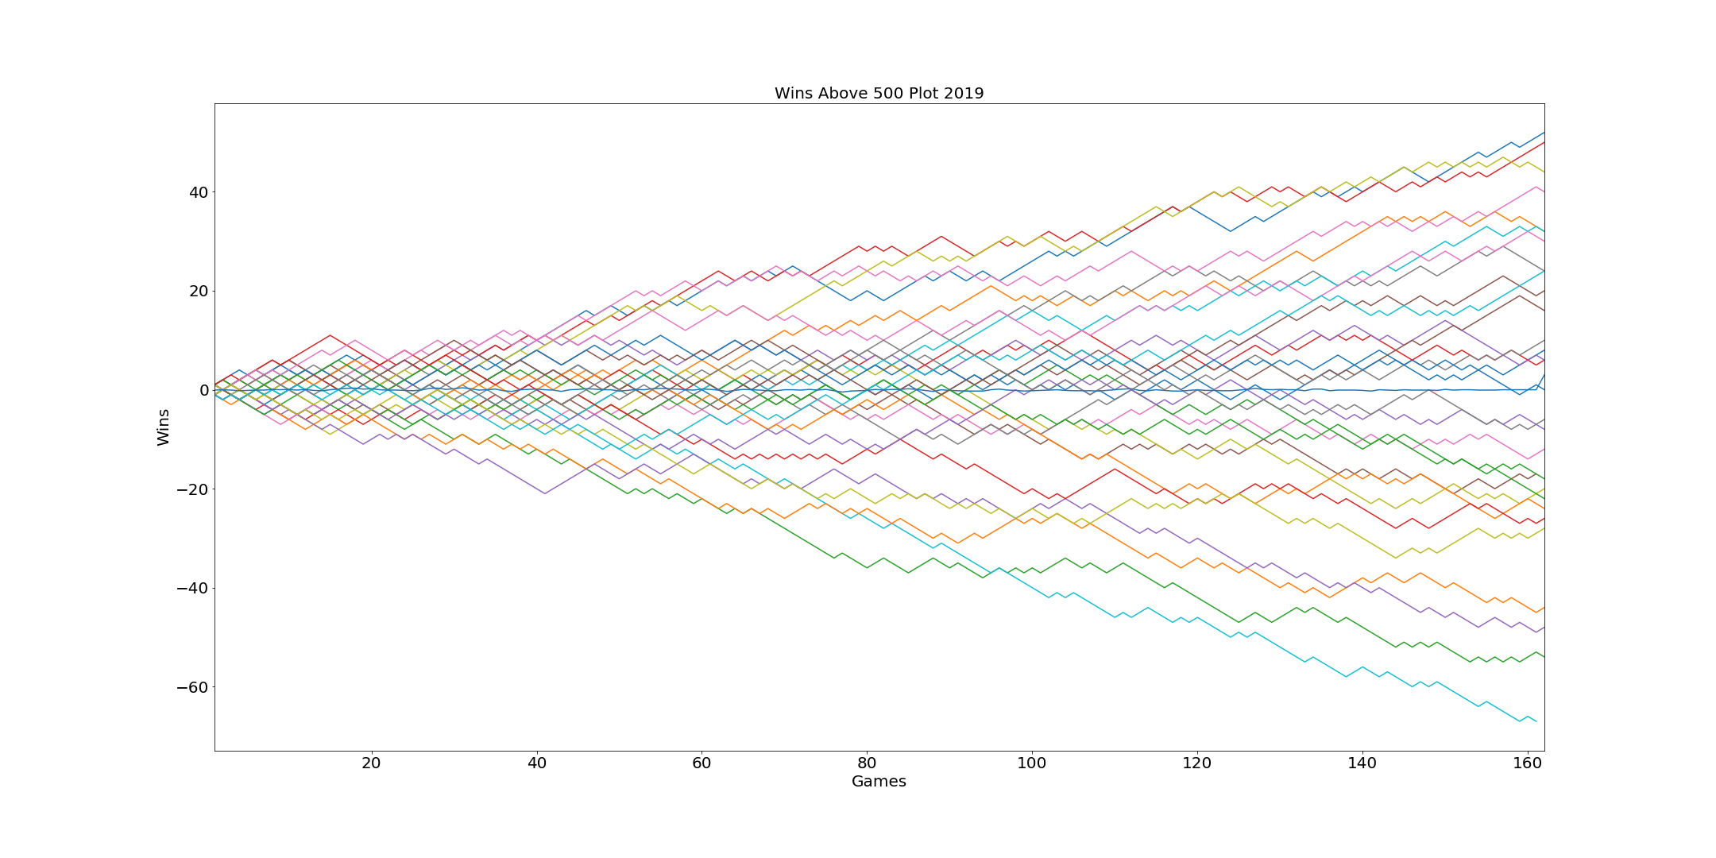

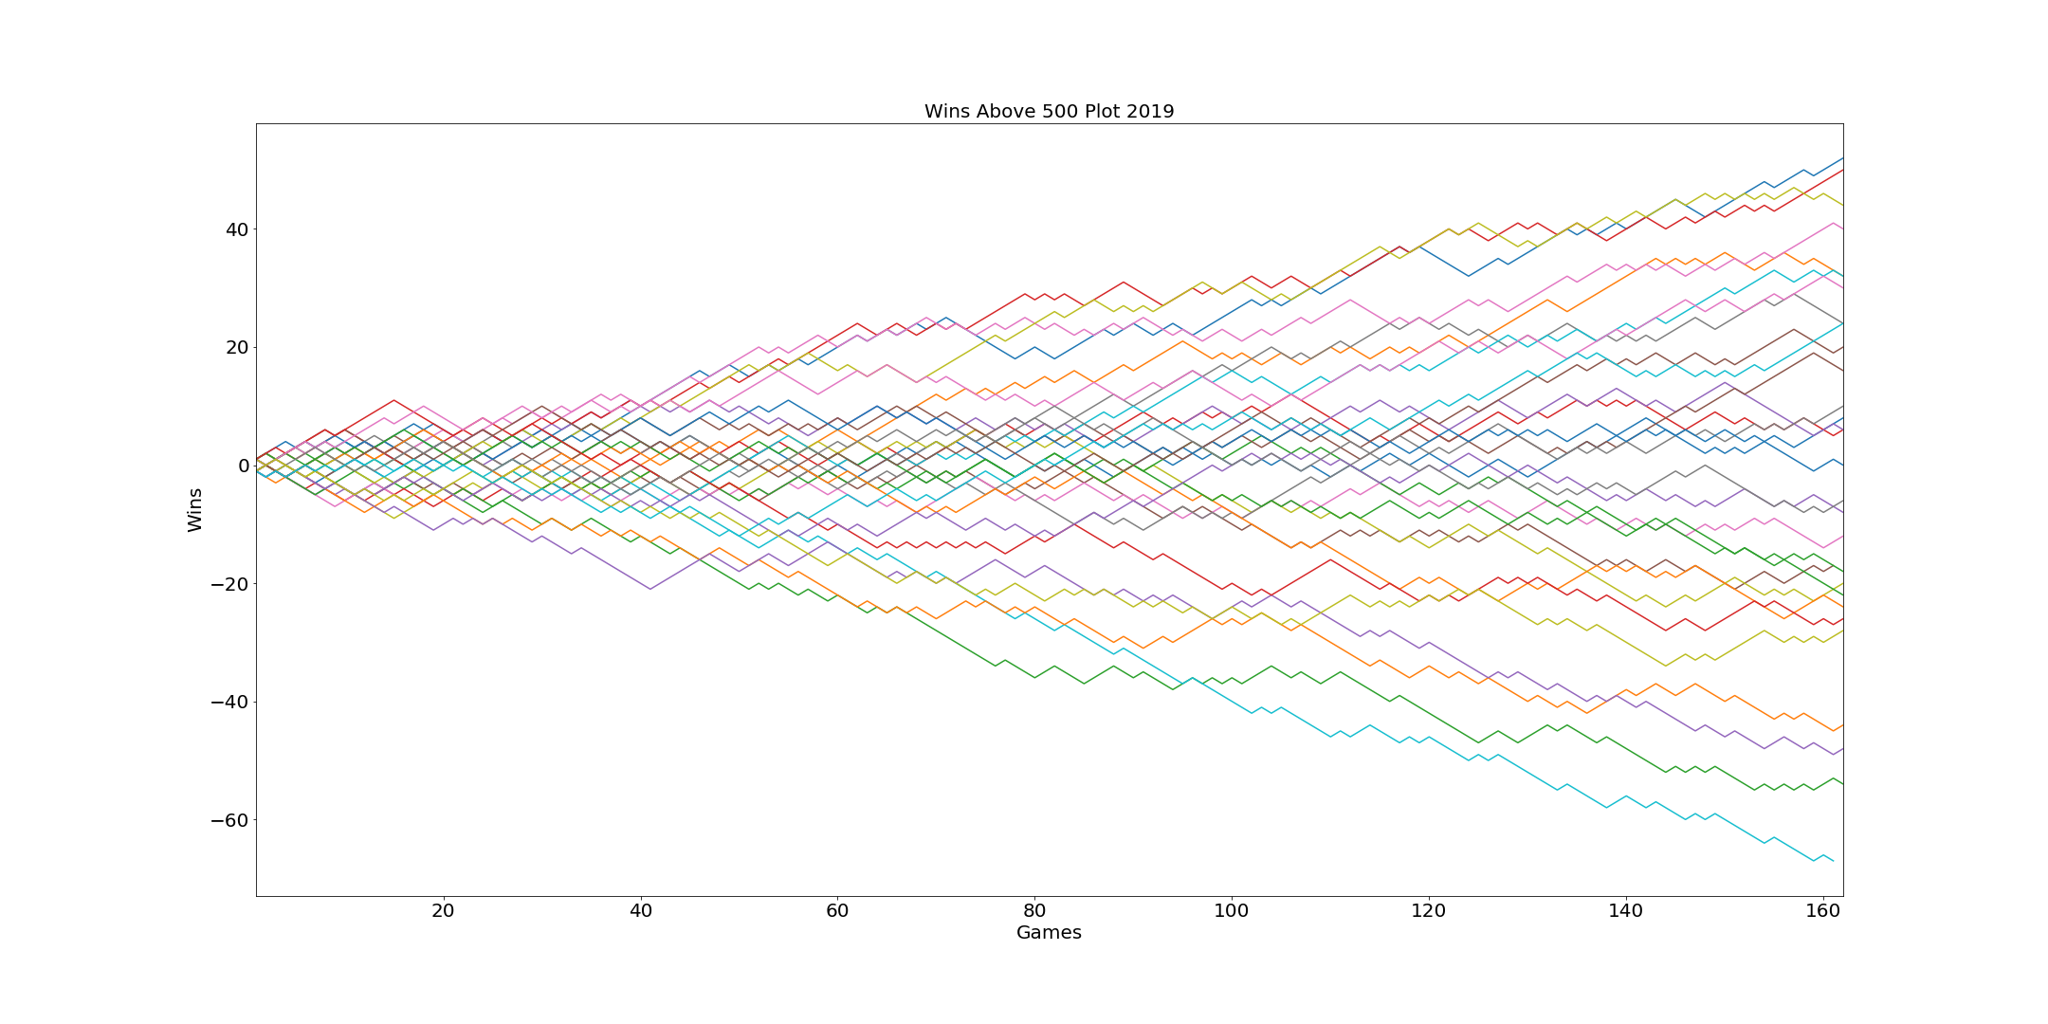
Why?

Slide 11


Recap
If we had started betting solely on underdogs since 2016, with an initial investment of $10,000, we would have made $ in total

Slide 12
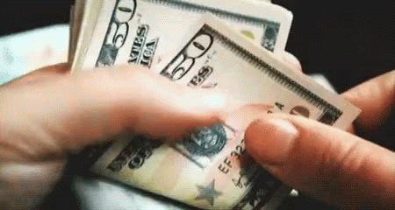
Conclusion

